Slide 1

Inferential Test Basics

Slide 2
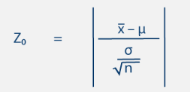
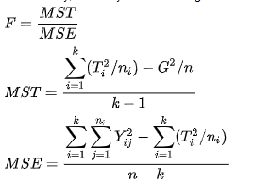
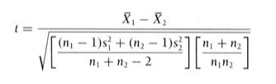

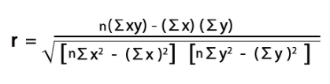
Hypothesis Testing
All inferential tests include a formula that quantifies what you are testing (test statistic).
One sample z-tes
Anova
t-test
Correlation

Slide 3
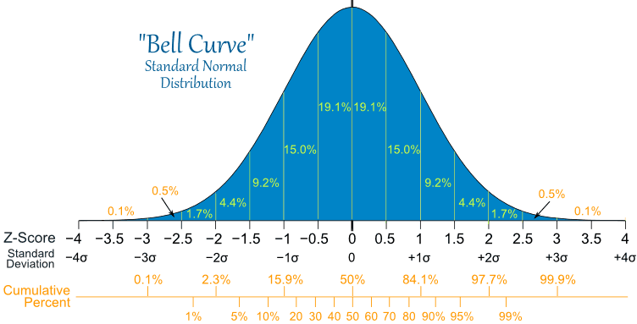
Normality, Probability and Significance
Why did we spend all that time on normality?
We use the normal distribution curve to determine the probability of a given value occurring for a standard normal population

Slide 4
Hypothesis Testing
If the probability (area under the curve) of calculating a test score that extreme is less than our significance threshold (usually 0.05), we can say we have a significant result.
The rest (95% in the middle) is likely due to random chance and is not significant

Slide 5
Expanding on Hypothesis Testing
Typically, a significant result is what you “want” to see.
To keep us honest, we set our p-value threshold for significance before we do any math.
Typically, we use p< 0.05
But you can justify increasing that (e.g. p< 0.1) if you know that the power of the test is low)
or decreasing that (e.g. p< 0.01) if you are working with extremely large data.

Slide 6
Expanding on Hypothesis Testing
To keep us honest, we also have to specify if we are conducting a 1- or 2-tailed test.
1-tailed tests:
specify the directionality of any significant difference or relationship you hypothesize you will see

Slide 7
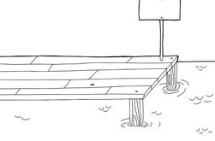

Significant or Not?
1-tailed – hypothesis incudes an expected direction
P < x
This is the null
P > x
Alpha (significance threshold)
Alpha (significance threshold)
Usually 0.05
Usually 0.05
0.05 or 5% probability
0.05 or 5% probability
-2 -1 0 1 2
-1.645
1.645
Critical value for a left tailed test
Obtained Test Statistic Value
Critical value for a right tailed test
If your obtained test statistic falls beyond the critical value for your given Alpha threshold =
Significant result…….reject the null

Slide 8
Expanding on Hypothesis Testing
To keep us honest, we also have to specify if we are conducting a 1- or 2-tailed test.
2-tailed tests:
have no expected directionality hypothesized
Splits the 5% of the area under the curve that would be considered significant between both tails of the normal distribution curve
Are therefore less powerful tests (more likely to find a significant result)

Slide 9
Significant or Not?
2-tailed- no specific direction implied in hypothesis
P < x OR P > x
This is the null
Alpha (significance threshold)
Alpha (significance threshold)
Usually 0.05
Usually 0.05
0.025 or 2.5% prob
0.025 or 2.5% prob
-2 -1 0 1 2
-1.96
1.96
Critical value for a 2-tailed test
Obtained Test Statistic Value
Critical value for a 2-tailed test
If your obtained test statistic falls beyond the critical value for your given Alpha threshold =
Significant result…….reject the null

Slide 10
Significant or Not?
Terminology basics:
Not significant =
Accept the null hypothesis,
there is no difference between the sample and population mean,
Obtained test statistic < critical value threshold
P- value > alpha threshold (usually 0.05)
Significant =
Reject the null hypothesis,
there IS a difference between the sample and population mean,
Obtained test statistic > critical value threshold
P- value < alpha threshold (usually 0.05)

Slide 11
Basic Steps for an Inferential Test
Assume that you have a research question and data in hand
Follow these steps:
A statement of null hypothesis.
Choose the appropriate test.
Set the level of Type I error risk (alpha)
Analyze data distribution
Compute the test statistic (obtained) value
Assess significance:
Determine the critical value needed to reject the null hypothesis and compare it to your calculated test statistic
Determine the p-value associated with your calculated test statistic
Summarize
(Know the research Hypothesis)
Including if a 1 or 2-tailed test
Usually < 0.05 but adjustable to manage power
(do you meet assumptions like normality and independence?)
Calculated from formula
|calculated| > critical value = significant
P-value < alpha threshold = significant
Clear, succinct paragraph with all pertinent information and interpretation
Notes:
Minute 2:09
P value is reporting the Probability that the Null Hypothesis is True

Slide 12
We can select an appropriate test simply by answering some questions.
What type of data do we have?
If we have Frequency Data, we select the Chi-square family
Continuous and categorical variables will have a variety ofdifferent tests depending on the research question:
What type of research question are we considering?
If comparing one sample mean to a population = z-test
If focus is on differences we go to the family of tests concerned with comparing groups or treatments (i.e. t-tests, ANOVA).
If the focus is on relationships between variables, we go to the correlation tests.
If we want to predict outcomes we go to the regression family
y = b + mx
intercept
slope

Slide 13
We can select an appropriate test simply by answering some questions.
How many variables, how many groups are we including? (multivariate)
Are observations independent from each other or purposely paired?
Is my data not normally distributed? (non-parametric tests)

Slide 14
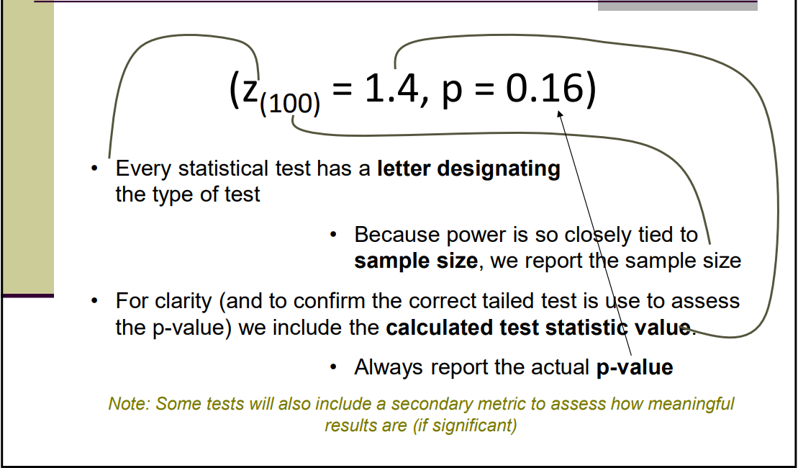
Statistical Shorthand z-test example

Slide 15
How to summarize your analysis Key Components of a Statistical Summary
Before installing a new air quality monitoring instrument, we tested to see if a sample of measurements taken at the testing lab differed significantly different from the long-term mean for the larger network population.
Using a 2-tailed, one-sample z-test for on our normally distributed samples (W = 0.78).
While the mean of the new instrument sample was slightly higher (sample mean = 117 vs. population mean = 108), we found no significant difference (z₍₁₀₀₎ = 1.4, p = 0.16)
Based on these results we approve the installation of this instrument at the new site. However, we would suggest statistical comparisons of the current and new unit side-by-side, prior to decommissioning the current instrument.

Slide 16
How to summarize your analysis Key Components of a Statistical Summary
Introduction/Background:
Before installing a new air quality monitoring instrument, we tested to see if a sample of measurements taken at the testing lab differed significantly different from the long-term mean for the larger network population.
Methods:
Using a 2-tailed, one-sample z-test for on our normally distributed samples (W = 0.78).
Results:
While the mean of the new instrument sample was slightly higher (sample mean = 117 vs. population mean = 108), we found no significant difference (z₍₁₀₀₎ = 1.4, p = 0.16)
Implications:
Based on these results we approve the installation of this instrument at the new site. However, we would suggest statistical comparisons of the current and new unit side-by-side, prior to decommissioning the current instrument.

Slide 17
Our First Inferential Tests!!!
Z-scores and the one sample z-test

Slide 18

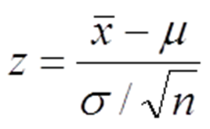
When would you run a one-sample z-test?
Use the One Sample z-test when:
You want to test for a difference between one sample mean and a larger population mean
There is only one group (sample) being tested against the larger population
You know (or can estimate) the mean and standard deviation of the population
Data is normally distributed
Your formula: .

Slide 19
When would you run a one-sample z-test?
Use the One Sample z-test when:
You want to test for a difference between one sample mean and a larger population
There is only one group being tested against the larger population
You know (or can estimate) the mean and standard deviation of the population
Data is normally distributed
Expert Information
Scientific Literature
Data archives
Meaningful (hypothesized value)

Slide 20
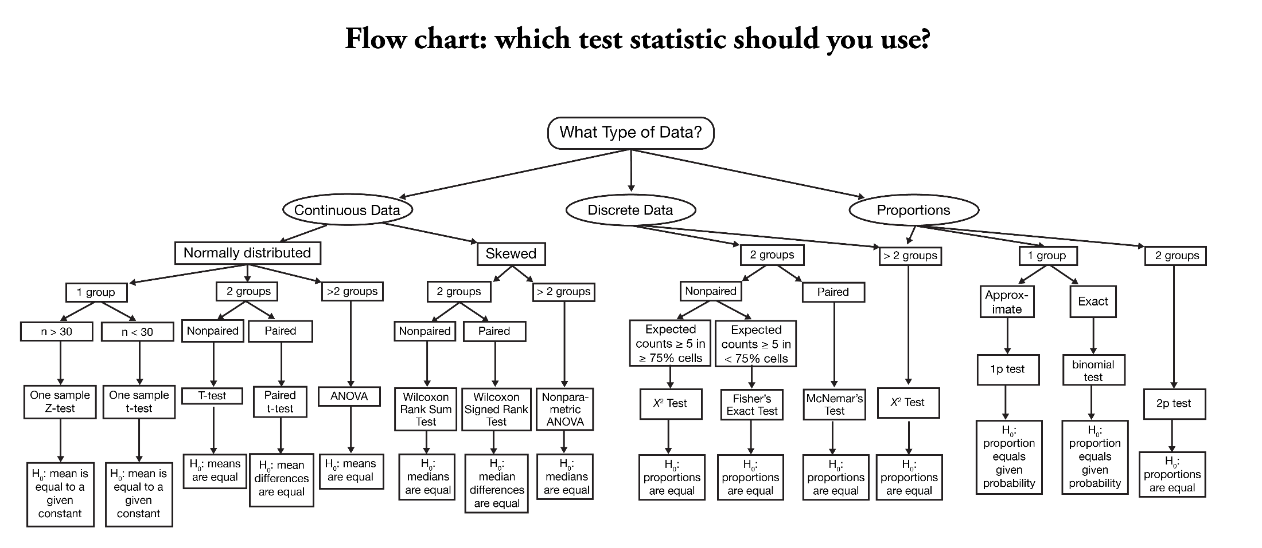
Flowcharts: Keeping it simple with questions

Slide 21
When would you run a one-sample z-test?
Type of Response Data
Continuous Counts (Frequency) Categorical
Research Question
Difference Relationships Predictions
# Samples to Compare
One Two >Two
Parametric
Non-Parametric
One sample z-test
Keywords: One sample
Population
Difference
Wilcoxon signed rank
z-test

Slide 22
When would you run a one-sample z-test?
Z-test (one sample compared to a population)
We tested to see if the hatchling success rate of 10 micro-plastics exposed turtle nests was lower than the hatchling success in the general population.
t-test (two samples compared to each other)
We tested to see if there was a significant difference between hatching rates of turtles who have consumed microplastics versus those that have not.

Slide 23
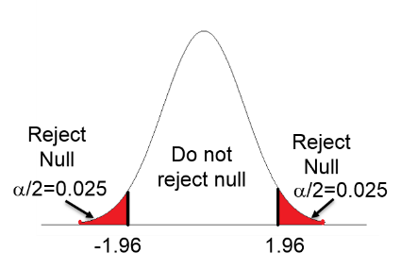
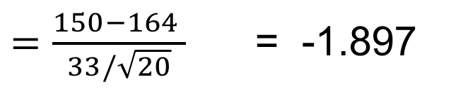
Sample Questions
Assume you have a sample of 20 observations.
The mean of this sample is 150 and you just want to see if there is a difference between the sample mean and larger population mean (you don't specify a direction for this difference) = 2 tailed test
Population mean = 164 and population standard deviation is 33
Calculate the obtained value for this one-sample z-test
There is no significant difference
between our sample and the population.
Follow these steps:
A statement of the hypothesis.
Describe your data
Choose the appropriate test based on
your hypothesis.
Compute the test statistic value and find
the appropriate p-value for your result
Assess significance Summarize
$=\frac{150−164 }{33/\sqrt{20}}$ = -1.897

Slide 24
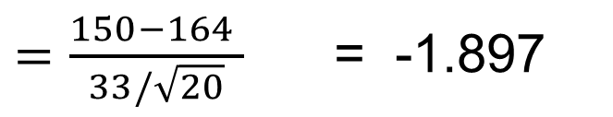
Sample Questions
Assume you have a sample of 20 observations.
The mean of this sample is 150 and you just want to see if there is a difference between the sample mean and larger population mean (you don't specify a direction for this difference) = 2 tailed test
Population mean = 164 and population standard deviation is 33
Calculate the obtained value for this one-sample z-test
$=\frac{150−164 }{33/\sqrt{20}}$ = -1.897
$=\frac{150−164 }{33/\sqrt{20}}$ = -1.897
This is the number of standard deviations away from the mean our sample is!

Slide 25
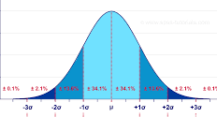
Sample Questions
Assume you have a sample of 20 observations.
The mean of this sample is 150 and you just want to see if there is a difference between the sample mean and larger population mean (you don't specify a direction for this difference) = 2 tailed test
Population mean = 164 and population standard deviation is 33
Calculate the obtained value for this one-sample z-test
$=\frac{150−164 }{33/\sqrt{20}}$ = -1.897
$=\frac{150−164 }{33/\sqrt{20}}$ = -1.897
kinda here maybe
This is the number of standard deviations away from the mean our sample is!

Slide 26
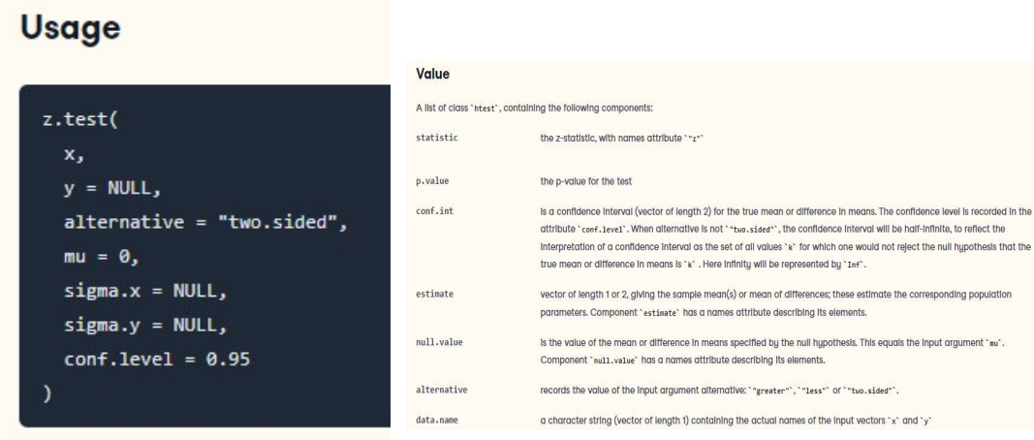
One-sample z-test example
Now you need to find the probability (p-value) associated with this calculated test statistic.

Slide 27
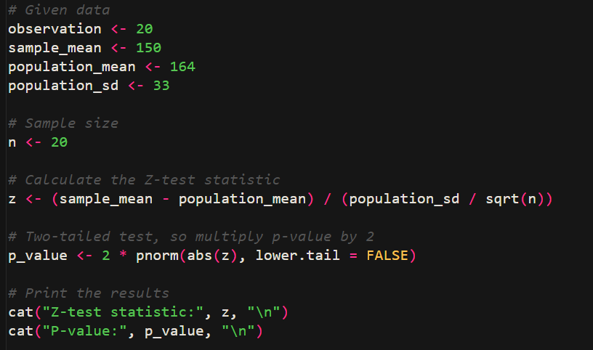
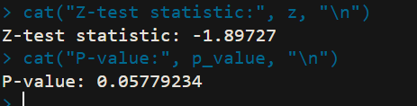
One-sample z-test example

Slide 28
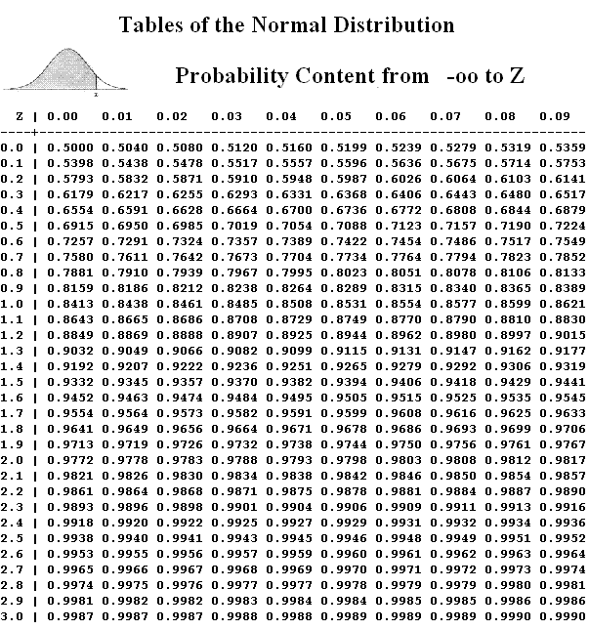
Quiz Questions
Now you need to find the probability (p-value) associated with this calculated test statistic.
You have several options to get there:
Use a Standard normal table to find critical values for significance.
you don't specify a direction for this difference = 2-tailed test
You don’t specify an alpha threshold = we use the default 0.05
For a 2-tailed test we have to split that 5% into the two tails (0.025)
Since our table gives us p<z we need to find p 0.975
Looking up that probability in the table we get a critical x of 1.96

Slide 29
Quiz Questions
Now you need to find the probability (p-value) associated with this calculated test statistic.
You have several options to get there:
2. Use excel to find the critical value for significance.
=normsinv(0.975) = 1.9599

Slide 30
Quiz Questions
Now you need to find the probability (p-value) associated with this calculated test statistic.
You have several options to get there:
2. Use excel to find the critical value for significance.
=normsinv(0.975) = 1.9599

Slide 31
Quiz Questions
Now you need to find the probability (p-value) associated with this calculated test statistic.
You have several options to get there:
If you use the critical value approach, you just need to compare what you calculated to the critical value.
If |calculated test statistic| > critical value = SIGNIFICANT
|-1.897| < 1.9599
NOT SIGNIFICANT

Slide 32
Quiz Questions
Now you need to find the probability (p-value) associated with this calculated test statistic.
You have several options to get there:
3. Use excel to find the ACTUAL probability associated with your calculated test statistic.
=normsdist(-1.897) = 0.0289
Note that because this was a 2-tailed test, we had to be “looking” for calculated values for both left and right tails. So the appropriate p-value for this must include probabilities for both tails. So the true p-value for this test is:
=normsdist(-1.897) * 2 = 0.0578
Because this p-value > 0.05 alpha threshold
= NOT SIGNIFICANT

Slide 33
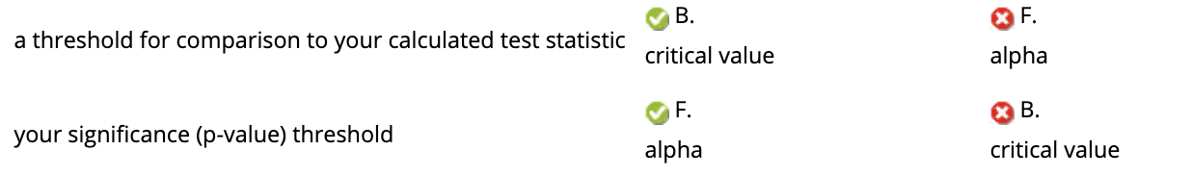
Quiz Questions
=normsdist(-1.897) = 0.0289
Note that because this was a 2-tailed test, we had to be “looking” for calculated values for both left and right tails. So the appropriate p-value for this must include probabilities for both tails. So the true p-value for this test is:
=normsdist(-1.897) * 2 = 0.0578
Because this p-value > 0.05 alpha threshold
= NOT SIGNIFICANT
1.9599
0.05
Notes:
Critical value
Alpha

Slide 34
Quiz Questions
Is there a significant difference between your sample mean and population mean?
Conclusion:
(z₍₂₀₎ = -1.897, p = 0.0578)
= not significant (p<0.05)
Accept the null hypothesis
There is no significant difference between the sample and population means
Any difference is likely due to random chance

Slide 35
Another example

Slide 36
One sample z-test Example
Keeping Companies Honest:
A rental car company claims the mean time to rent a car on their website is 60 seconds with a standard deviation of 30 seconds. A random sample 36 customers attempted to rent a car on the website. The mean time to rent was 75 seconds. Is this enough evidence to contradict the company's claim?
This claim is made broadly = an assumed population mean
We want to test this claim with our own sample

Slide 37
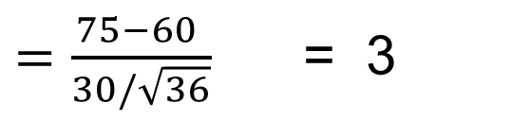
Remember the basic Steps of any statistical analysis
1. H₁: Sample time to rent a car online is greater than stated by the company.
2. p< 0.05.
3. Normal Distribution
4. One sample z-test (one tailed (right)….is actual time longer than stated)
5. Compute the test statistic (obtained) value
 = 75
µ = 60
Where: σ = 30
n = 36
$=\frac{75−60 }{30/\sqrt{36}}$ = 3

Slide 38
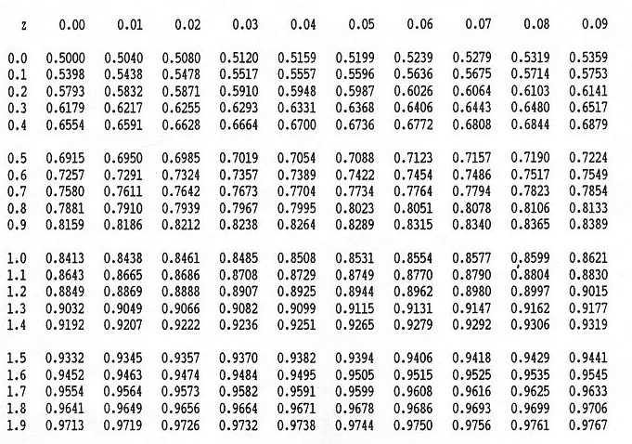
Remember the basic Steps of any statistical analysis
1. H1: Sample time to rent a car online is greater than stated by the company.
2. p< 0.05.
3. Normal Distribution
4. One sample z-test (one tailed….is time longer than stated)
5. Compute the test statistic (obtained) value = 3
6. critical value (1 tailed p<0.950) =
 = 75
µ = 60
Where: σ = 30
n = 36
1.645

Slide 39
Remember the basic Steps of any statistical analysis
1. H1: Sample time to rent a car online is greater than stated by the company.
2. p< 0.05.
3. Normal Distribution
4. One sample z-test (one tailed….is time longer than stated)
5. Compute the test statistic (obtained) value = 3
6. critical value (1 tailed p<0.950) =
 = 75
µ = 60
Where: σ = 30
n = 36
1.645
7. Compare
8. Conclude
Obtained |3.0| > Critical (1.645)
= significant difference, reject the null hypothesis
= actual time for our sample significantly exceeded the time claimed by the company

Slide 40
Remember the basic Steps of any statistical analysis
1. H1: Sample time to rent a car online is greater than stated by the company.
2. p< 0.05.
3. Normal Distribution
4. One sample z-test (one tailed (right)….time longer than stated population)
5. Compute the test statistic (obtained) value = 3
6. critical value (1 tailed p<0.950) =
 = 75
µ = 60
Where: σ = 30
n = 36
Report the actual P-value whenever possible
In excel
=normsdist(3) = 0.99865
But we did a right tailed test so….
1 - .99865 = 0.00135
1.645
7. Compare
8. Conclude
Obtained (3.0) > Critical (1.645)
= significant difference, reject the null hypothesis
= actual time for our sample significantly exceeded the time claimed by the company

Slide 41
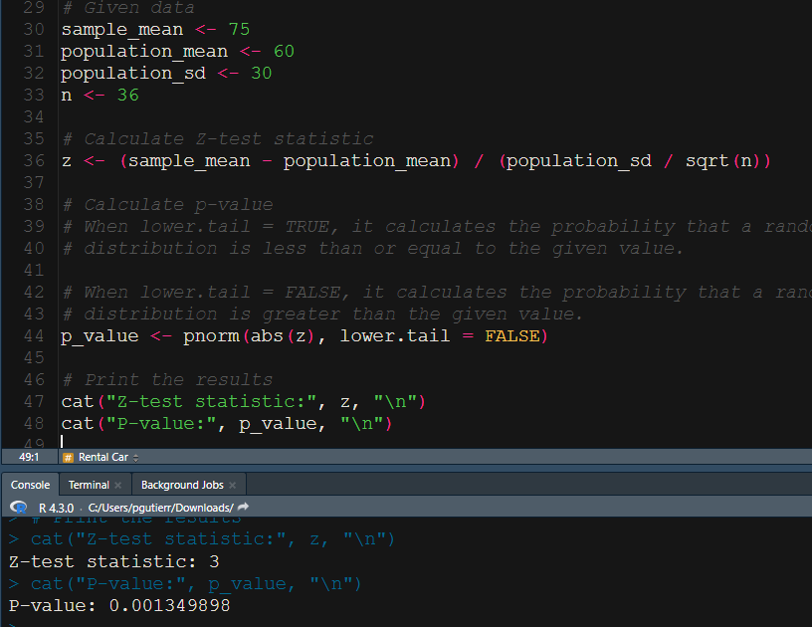
Rental car example in R

Slide 42
Summarizing your Analysis
Paragraph summary should include:
Statement of the research question or objectives.
General summary of methods
Statement of your results (including shorthand for your results)
(z_{(n)} = z-stat, p-value)
Interpretation of your results and conclusion (big picture, what does this mean)

Slide 43
Summarizing your Analysis
Car rental example:
We tested a rental car company’s claim that reservations could be made online in 60 seconds on average. Using a random sample of 36 online rentals in a one-tailed, one-sample z-test we found that mean reservation time is actually significantly higher than the company claims (z₍₃₆₎₌3, p = 0.002). This result indicates that it is highly unlikely customers can rent a car in 60 seconds as claimed. We suggest that the rental company adjust its claim to match the 75 second mean encountered for our test sample to avoid misleading potential customers.

Slide 44
Another example
IQ: A k-5 mentoring program across the state has been supporting youth to support their brain development. We want to see if mentored students have asignificantly higher IQ in grade 5, compared to the general population of fifth graders.
Where:  (mentored students) = 104
µ (population mean) = 100
σ (population standard deviation) = 15
n = 50

Slide 45
Summarizing your Analysis
IQ example:
We tested to see if a group of mentored students had significantly higher IQ than the general population. Using a sample of 50 students with long-term mentoring and a one-sample z-test we found that mean mentor IQ was significantly higher (z₍₅₀₎ = 1.76, p = 0.04). While only marginally significant, these results suggest that mentoring may have added long-term benefits for students.

Slide 46
Group Work

Slide 47

One-Sample z-test Group Work
global land and sea temperature anomalies from 1880 to 2016 as recorded by NASA
Our task will be to compare a mean Historical sample, and then an Anthropocene sample to the Baseline “population” annual global temperature anomaly using one-sample z-tests.

Slide 48
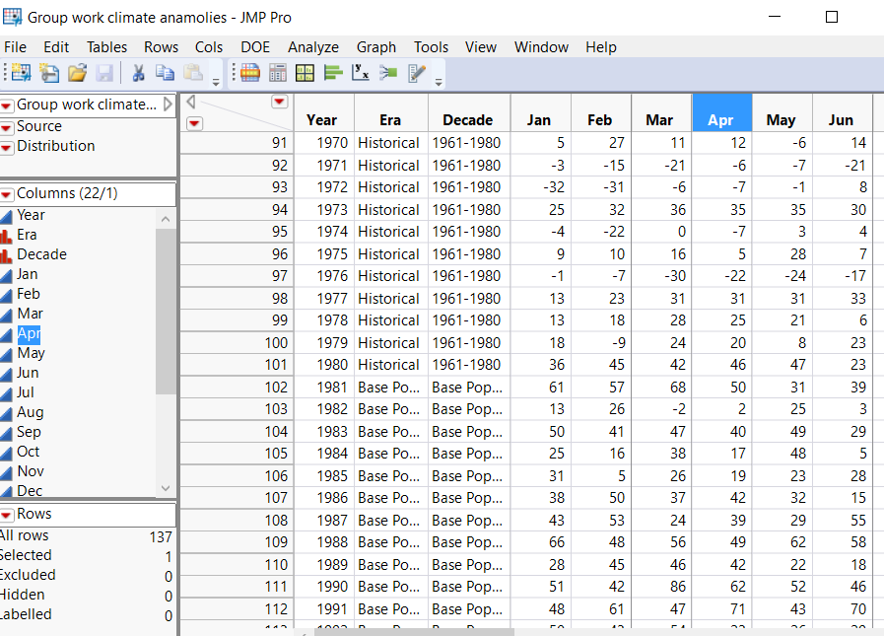
One-Sample z-test Group Work
The Baseline population is the 30 year climate period between 1981 and 2010

Slide 49
Todays One-Sample z-group work
Use the Annual Anom J-D Column (for the yearly average anomaly)
Test to see if there is a significant difference between the historical data sample mean (historical era) compared to the NASA defined baseline population mean of temperatures (baseline population)
Repeat this whole process but this time comparing the few years we have in the “Anthropocene” era to the baseline population mean.

Slide 50
One-Sample z-test Group Work
Note that the sample and population data are all contained in one column (bummer) ….
You have two options in JMP

Slide 51
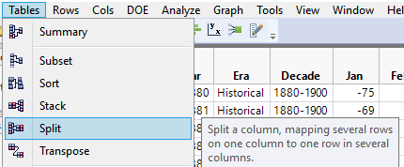
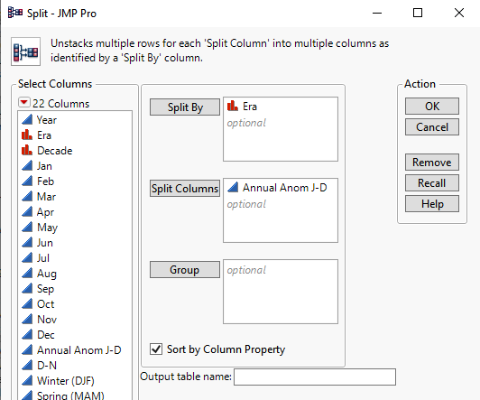
One-Sample z-test Group Work
1. You can split the response variable based on era classification from:
TABLES
SPLIT

Slide 52
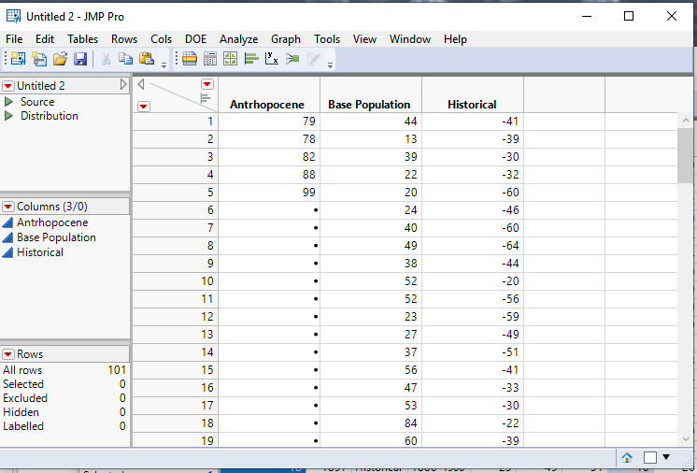
One-Sample z-test Group Work
1. You can split the response variable based on era classification from:
TABLES
SPLIT
Anthropocene sample (run your z-test in here)
Population (get your population stats from this)
Historical sample (run your z-test in here)

Slide 53
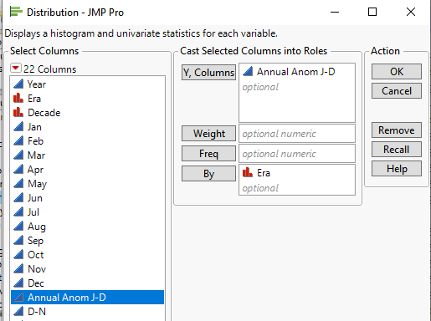
One-Sample z-test Group Work
2. You can split the response variable right in the ANALYZE distribution platform to get separate analyses for each ERA

Slide 54
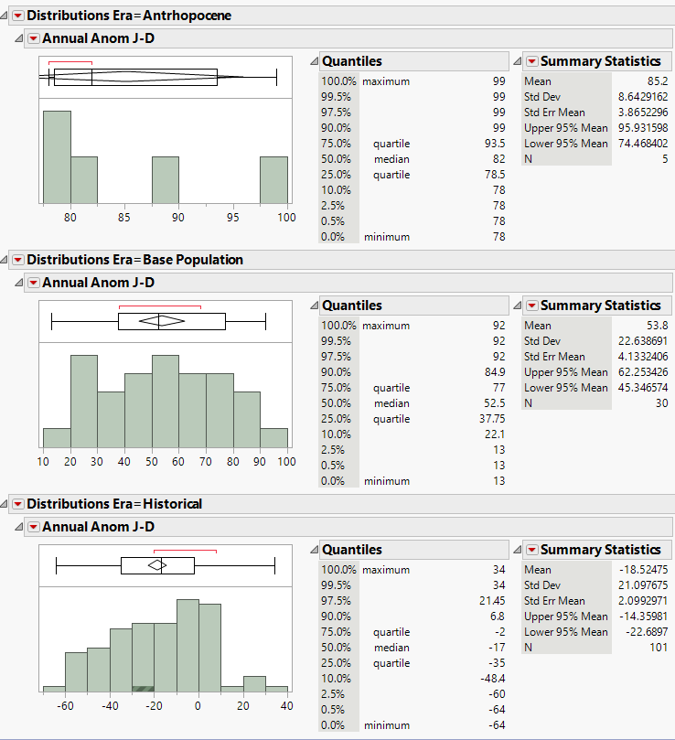
One-Sample z-test Group Work
2. You can split the response variable right in the ANALYZE distribution platform to get separate analyses for each ERA
Anthropocene sample (run your z-test in here)
Population (get your population stats from this)
Historical sample (run your z-test in here)

